Slide 1
Linear Regression and the
Bias Variance Tradeoff
Lectured by Shangsong Liang
Sun Yat-sen University
Notes:
Thanks to Joseph E. Gonzalez, Tom Mitchell

Slide 2
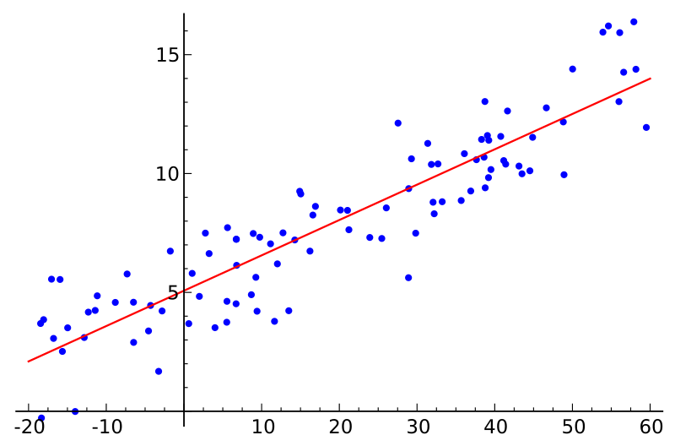

Simple Linear Regression
Y
X
Response
Variable
Covariate
Linear Model:
Slope
Intercept (bias)

Slide 3
Motivation
One of the most widely used techniques
Fundamental to many larger models
  Generalized Linear Models
  Collaborative filtering
Easy to interpret
Efficient to solve

Slide 4
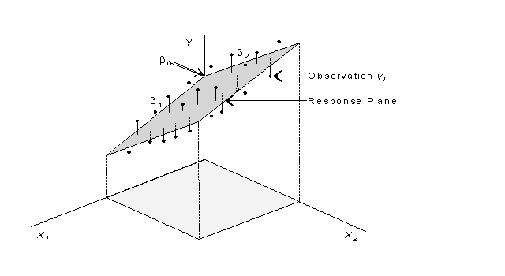
Multiple Linear Regression

Slide 5



The Regression Model
For a single data point (x,y):
Joint Probability:
Independent Variable
(Vector)
Response Variable
(Scalar)
x
Observe:
(Condition)
x
y
Discriminative
Model

Slide 6


Slide 7
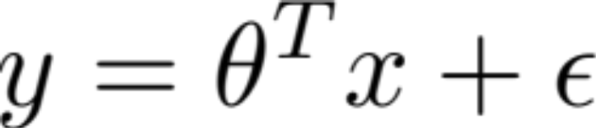
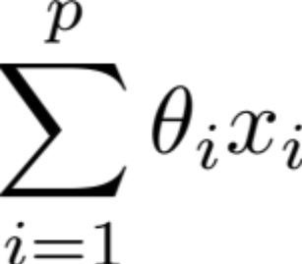


The Linear Model
Vector of
Parameters
Vector of
Covariates
+ b
Scalar
Response
Real Value
Noise
Noise Model:
Linear Combination
of Covariates
What about bias/intercept term?
Then redefine p := p+1 for notational simplicity

Slide 8
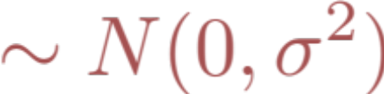
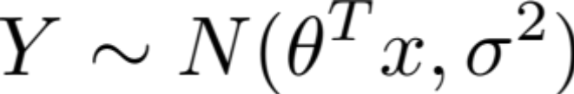
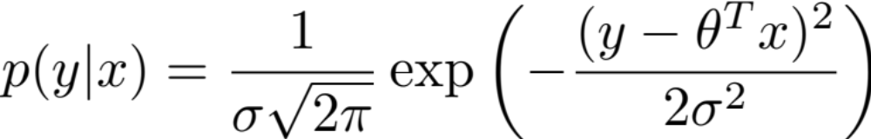
Conditional Likelihood p(y|x)
Conditioned on x:
Conditional distribution of Y:
Constant
Normal Distribution
Mean
Variance

Slide 9
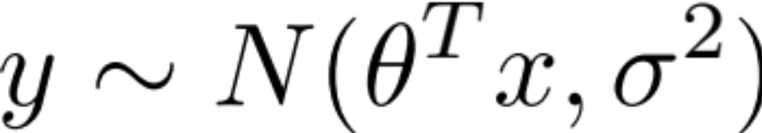
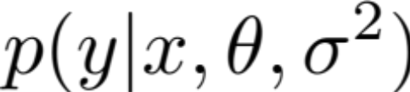
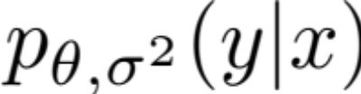
Parameters and Random Variables
Parameters
Conditional distribution of y:
  Bayesian: parameters as random variables
  Frequentist: parameters as (unknown) constants

Slide 10
So far …
Y
I’m lonely
*
X₂
X₁

Slide 11
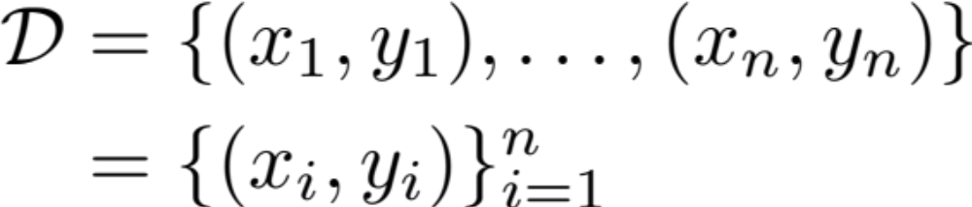



Independent and Identically Distributed (iid) Data
For n data points:
Plate Diagram
Independent Variable
(Vector)
Response Variable
(Scalar)
x_{i}
y_{i}

Slide 12

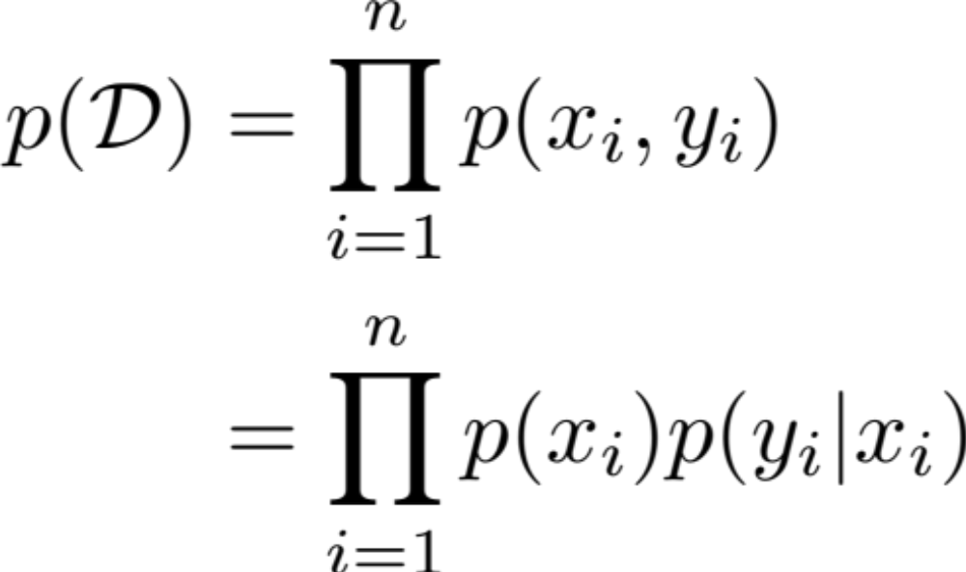
Joint Probability
x_{i}
y_{i}
For n data points independent and identically distributed (iid):

Slide 13







Rewriting with Matrix Notation
Represent data as:
Covariate (Design)
Matrix
Response
Vector
n
n
Assume X
has rank p
(not degenerate)
p
1

Slide 14
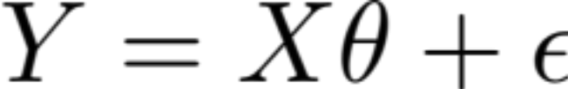




Rewriting with Matrix Notation
Rewriting the model using matrix operations:
= +
p
n
n
n
1
1
p
Notes:
\mathcal{L}(\mathcal{D}; \theta, \sigma^2)
& = \frac{1}{\sigma^n (2 \pi)^{\frac{n}{2}}} \exp\left( - \frac{1}{2 \sigma^2 } \sum_{i=1}^n (y_i - \theta^T x_i)^2 \right) \\

Slide 15
Estimating the Model
Given data how can we estimate θ?
Construct maximum likelihood estimator (MLE):
  Derive the log-likelihood
  Find θ_{MLE} that maximizes log-likelihood
    Analytically: Take derivative and set = 0
    Iteratively: (Stochastic) gradient descent

Slide 16
Joint Probability
x_{i}
x_{i}
y_{i}
For n data points:
“1”
Discriminative
Model

Slide 17
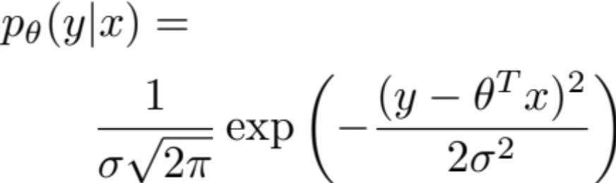
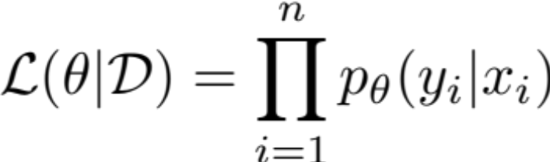
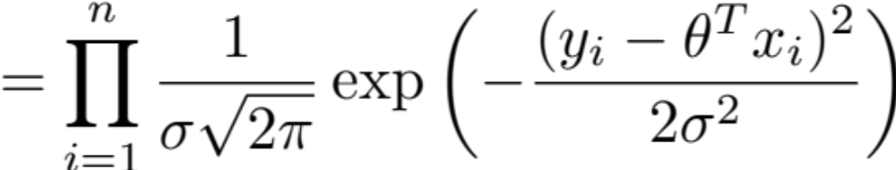
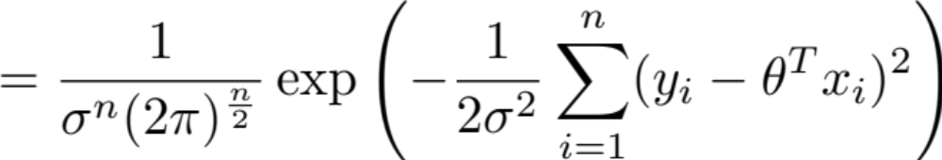
Defining the Likelihood
x_{i}
y_{i}

Slide 18
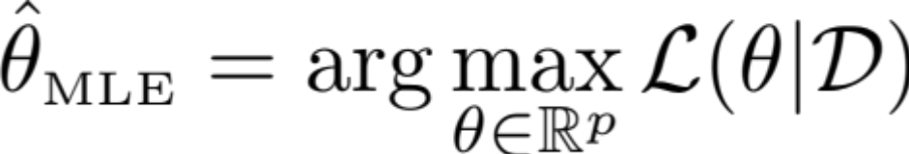
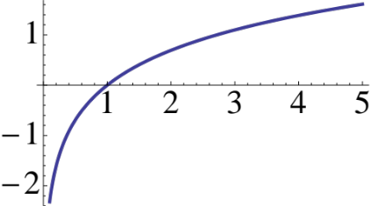
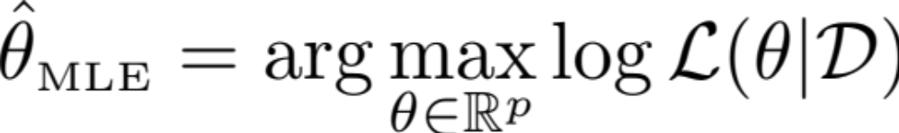
Maximizing the Likelihood
Want to compute:
To simplify the calculations we take the log:
which does not affect the maximization because log is a monotone function.

Slide 19
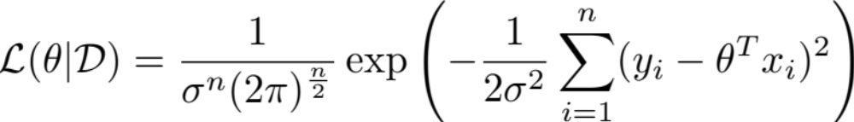
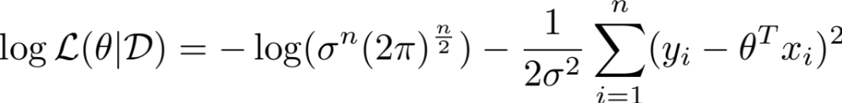
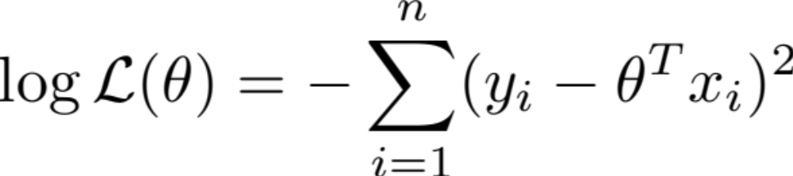
Take the log:
Removing constant terms with respect to θ:
Monotone Function
(Easy to maximize)
Notes:
P(\{Y\}_{i=1}^n | \{X\}_{i=1}^n)
& = \prod_{i=1}^n P(Y_i | X_i) \\
& \propto \prod exp\left( - \frac{(y - \theta^T x)^2}{2 \sigma^2 } \right)

Slide 20
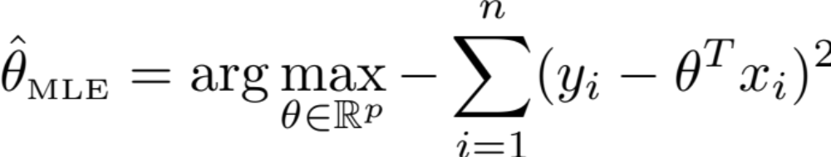
Want to compute:
Plugging in log-likelihood:
Notes:
P(\{Y\}_{i=1}^n | \{X\}_{i=1}^n)
& = \prod_{i=1}^n P(Y_i | X_i) \\
& \propto \prod exp\left( - \frac{(y - \theta^T x)^2}{2 \sigma^2 } \right)

Slide 21
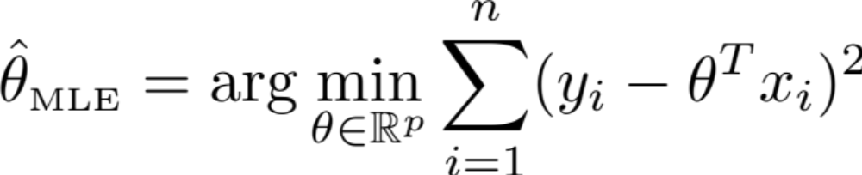
Dropping the sign and flipping from maximization to minimization:
  Gaussian Noise Model → Squared Loss
  Least Squares Regression
Minimize Sum (Error)²
Notes:
P(\{Y\}_{i=1}^n | \{X\}_{i=1}^n)
& = \prod_{i=1}^n P(Y_i | X_i) \\
& \propto \prod exp\left( - \frac{(y - \theta^T x)^2}{2 \sigma^2 } \right)

Slide 22
Pictorial Interpretation of
Squared Error
y
x

Slide 23


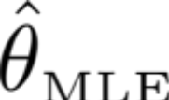
Maximizing the Likelihood
(Minimizing the Squared Error)
Convex Function
Slope = 0
Take the gradient and set it equal to zero
Notes:
P(\{Y\}_{i=1}^n | \{X\}_{i=1}^n)
& = \prod_{i=1}^n P(Y_i | X_i) \\
& \propto \prod exp\left( - \frac{(y - \theta^T x)^2}{2 \sigma^2 } \right)

Slide 24
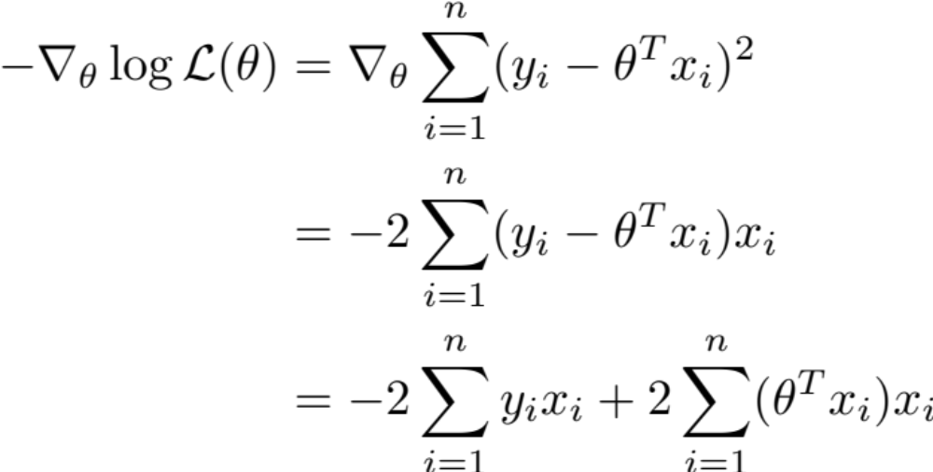
Minimizing the Squared Error
Taking the gradient
Chain Rule →

Slide 25
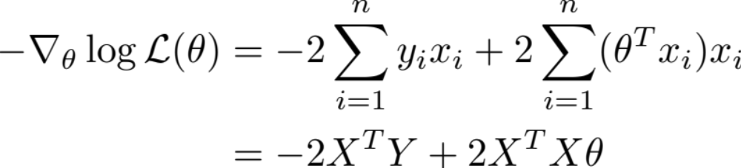

Rewriting the gradient in matrix form:
To make sure the log-likelihood is convex compute the second derivative (Hessian)
If X is full rank then X^{T}X is positive definite and therefore θ_{MLE} is the minimum
  Address the degenerate cases with regularization
Notes:
http://www.cs.berkeley.edu/~jduchi/projects/matrix_prop.pdf

Slide 26
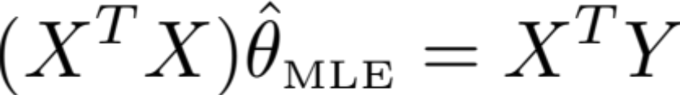
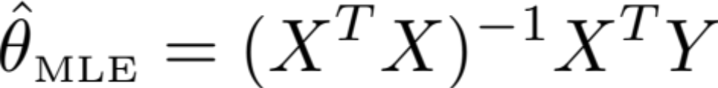
Setting gradient equal to 0 and solve for θ_{MLE}:
Normal
Equations
(Write on
board)
n
p
n
1
-1
p
=
Notes:
http://www.cs.berkeley.edu/~jduchi/projects/matrix_prop.pdf

Slide 27
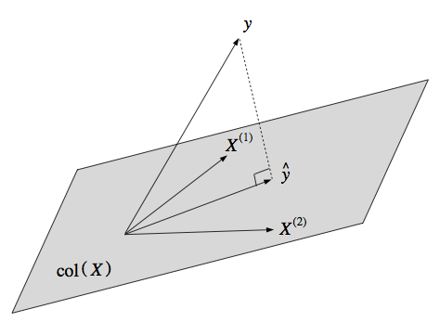


Geometric Interpretation
View the MLE as finding a projection on col(X)
  Define the estimator:
  Observe that Ŷ is in col(X)
    linear combination of cols of X
  Want to Ŷ closest to Y
Implies (Y-Ŷ) normal to X

Slide 28
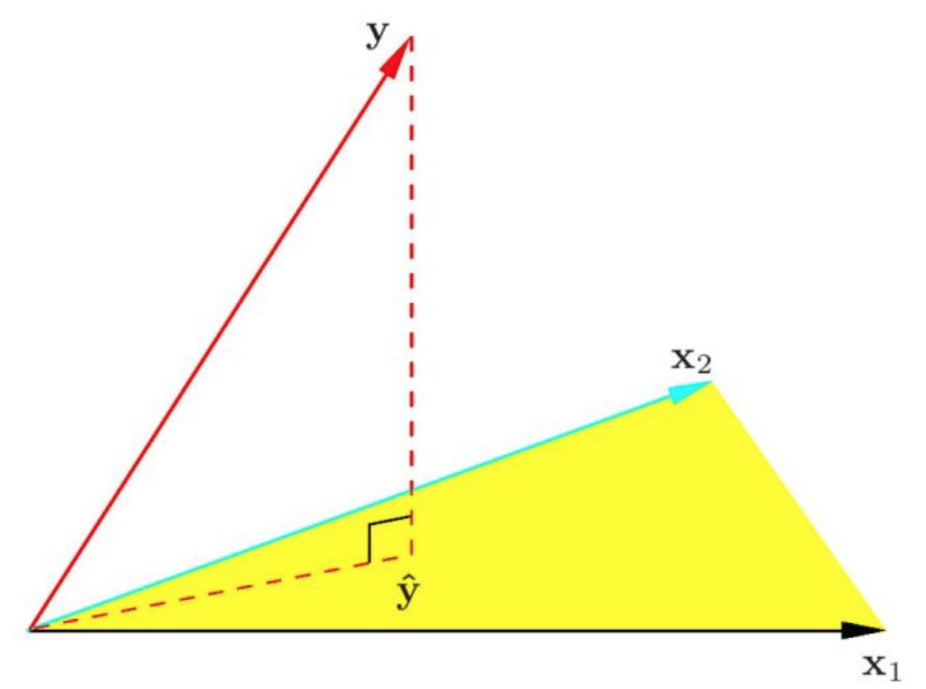
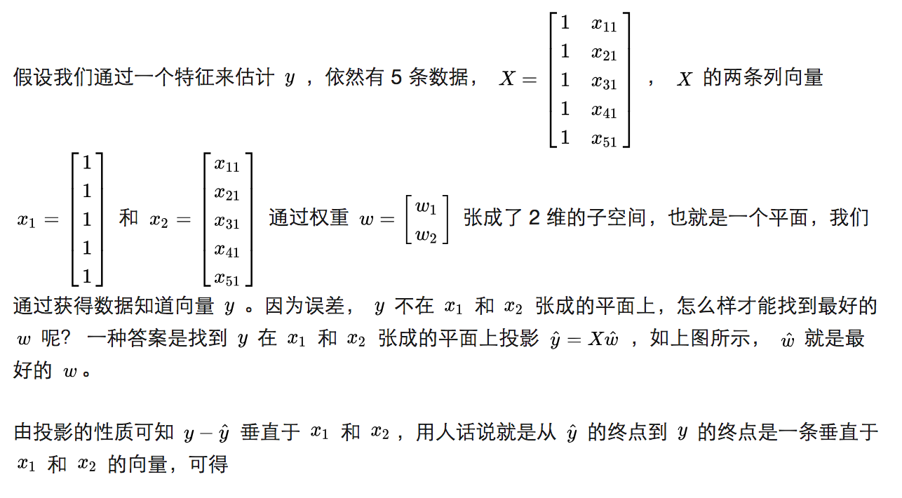
Geometric Interpretation

Slide 29
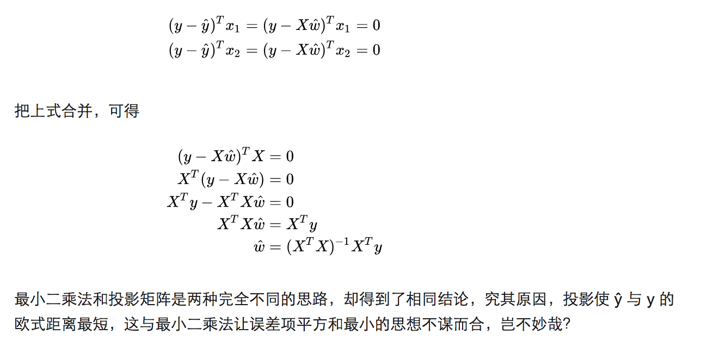
Geometric Interpretation

Slide 30

Connection to Pseudo-Inverse
Moore-Penrose
Psuedoinverse
Generalization of the inverse:
  Consider the case when X is square and invertible:
  Which implies θ_{MLE}= X⁻¹ Y the solution
  to X θ = Y when X is square and invertible

Slide 31
Computing the MLE
Not typically solved by inverting X^{T}X
Solved using direct methods:
  Cholesky factorization:
    Up to a factor of 2 faster
  QR factorization:
    More numerically stable
Solved using various iterative methods:
  Krylov subspace methods
  (Stochastic) Gradient Descent
or use the
built-in solver
in your math library.
R: solve(Xt %*% X, Xt %*% y)
http://www.seas.ucla.edu/~vandenbe/103/lectures/qr.pdf

Slide 32
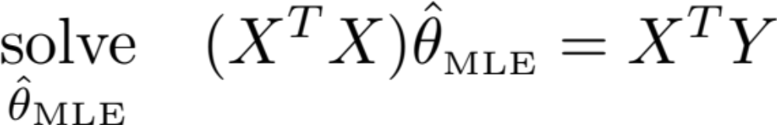









Cholesky Factorization
C
d
Compute symm. matrix
Compute vector
Cholesky Factorization
  L is lower triangular
Forward subs. to solve:
Backward subs. to solve:
Connections to graphical model inference:
http://ssg.mit.edu/~willsky/publ_pdfs/185_pub_MLR.pdf and http://yaroslavvb.blogspot.com/2011/02/junction-trees-in-numerical-analysis.html with illustrations

Slide 33
Solving Triangular System
A₁₁x₁
A₁₁
A₁₂x₂
A₁₂
A₁₃x₃
A₁₃
A₁₄x₄
A₁₄
x₁
b₁
A₂₂
A₂₃
A₂₄
x₂
b₂
=
*
A₃₃
A₃₄
x₃
b₃
A₄₄
x₄
b₄
Bonus Content

Slide 34
Solving Triangular System
A₁₁x₁
A₁₂x₂
A₁₃x₃
A₁₄x₄
b₁
x₁=b₁-A₁₂x₂-A₁₃x₃-A₁₄x₄
A₁₁
A₂₂x₂
A₂₃x₃
A₂₄x₄
b₂
x₂=b₂-A₂₃x₃-A₂₄x₄
A₂₂
A₃₃x₃
A₃₄x₄
b₃
x₃=(b₃-A₃₄x₄)
A₃₃
A₄₄x₄
b₄
Bonus Content
x₄=b₄ /A₄₄

Slide 35
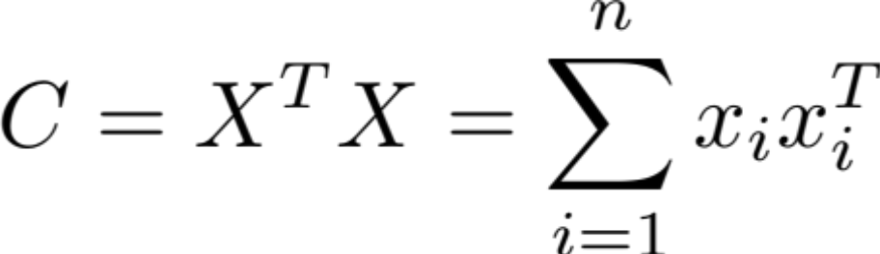
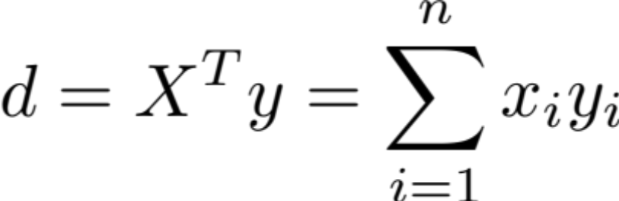
Distributed Direct Solution (Map-Reduce)
Distribution computations of sums:
Solve system C θ_{MLE} = d on master.
p
p
1
p

Slide 36
Gradient Descent:
What if p is large? (e.g., n/2)
The cost of O(np²) = O(n³) could by prohibitive
Solution: Iterative Methods
  Gradient Descent:
For τ from 0 until convergence
Learning rate

Slide 37




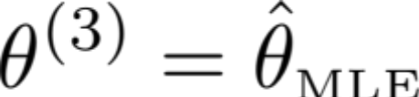
Gradient Descent Illustrated:
Slope = 0
Convex Function

Slide 38
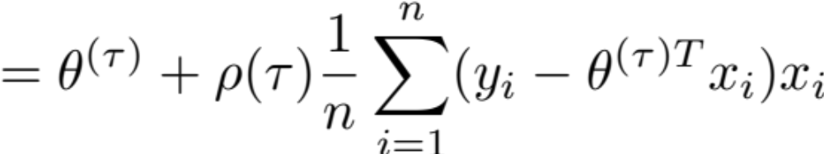
Gradient Descent:
What if p is large? (e.g., n/2)
The cost of O(np²) = O(n³) could by prohibitive
Solution: Iterative Methods
  Gradient Descent:
Can we do better?
For τ from 0 until convergence
Estimate of the Gradient

Slide 39

Stochastic Gradient Descent
Construct noisy estimate of the gradient:
Sensitive to choice of ρ(τ) typically (ρ(τ)=1/τ)
Also known as Least-Mean-Squares (LMS)
Applies to streaming data O(p) storage
For τ from 0 until convergence
1) pick a random i
2)

Slide 40
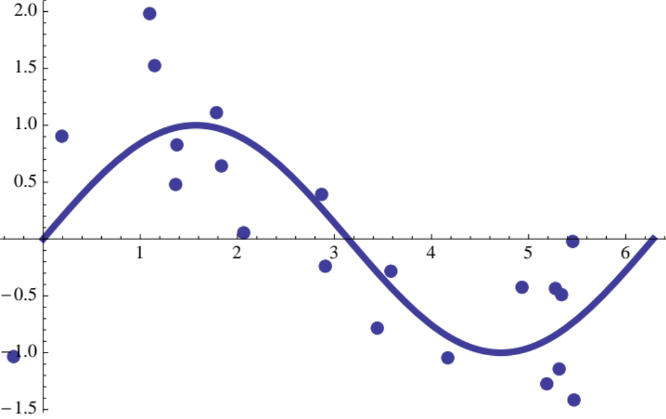
Fitting Non-linear Data
What if Y has a non-linear response?
Can we still use a linear model?

Slide 41


Transforming the Feature Space
Transform features x_{i}
By applying non-linear transformation ϕ:
Example:
  others: splines, radial basis functions, …
  Expert engineered features (modeling)

Slide 42
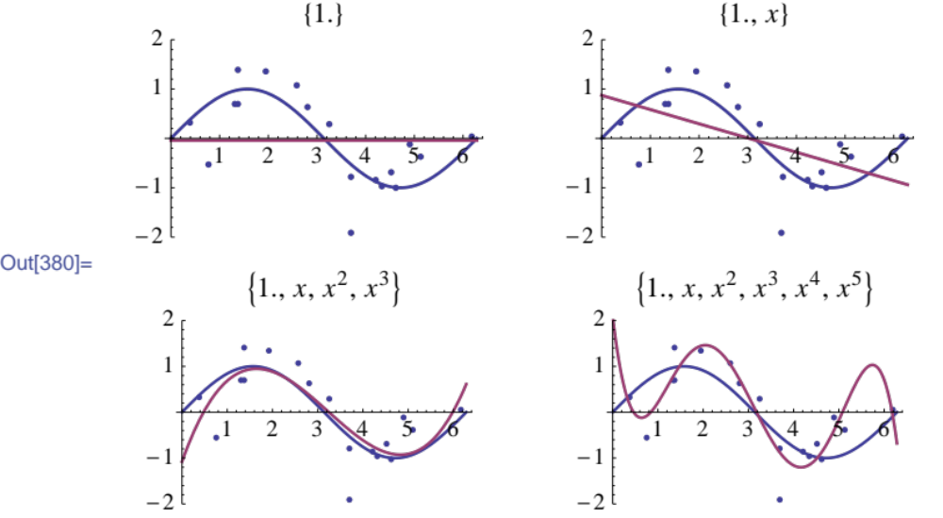
Under-fitting
Over-fitting

Slide 43
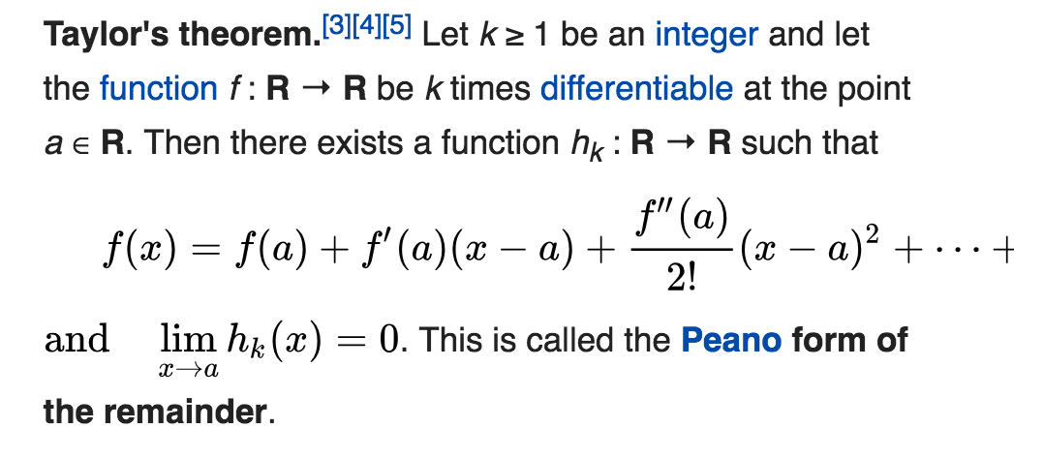
Over-fitting

Slide 44
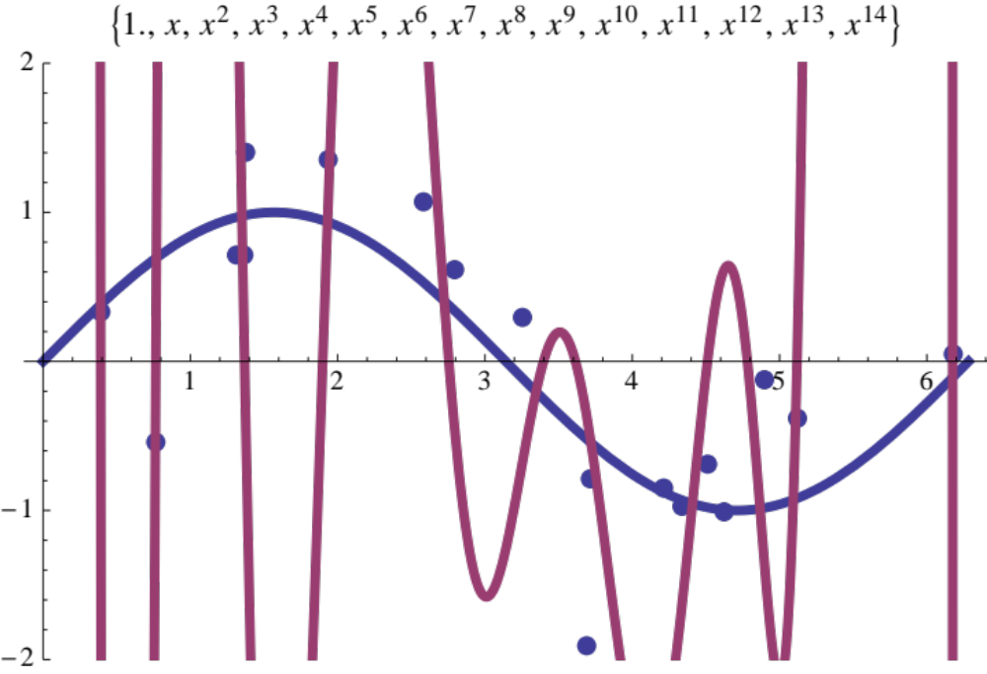
Really Over-fitting!
Errors on training data are small
But errors on new points are likely to be large

Slide 45
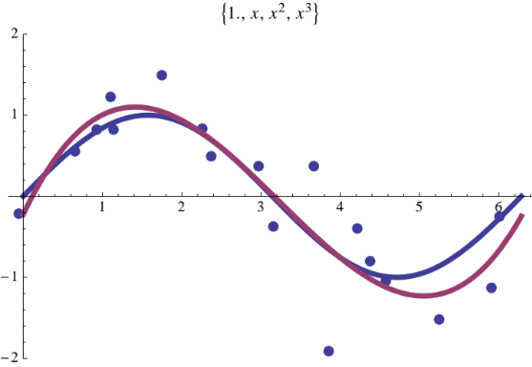
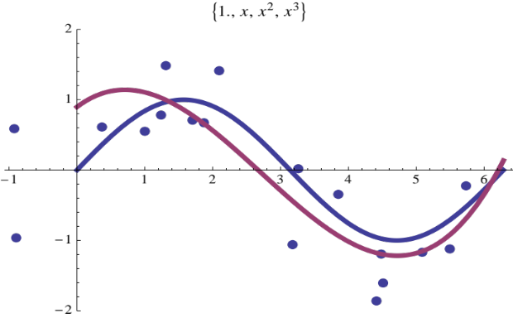
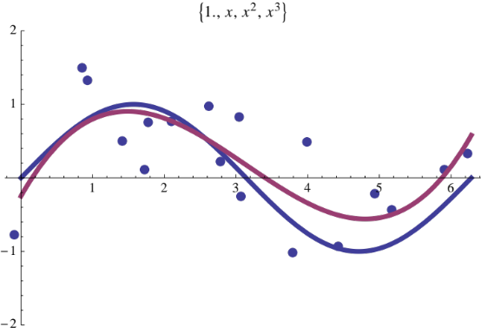
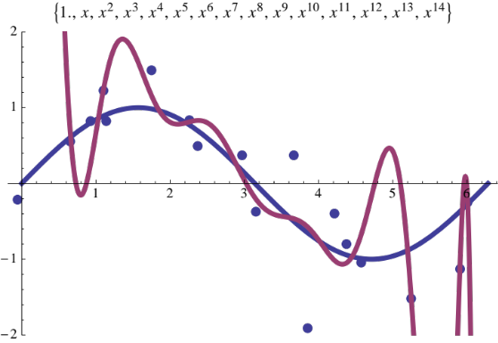
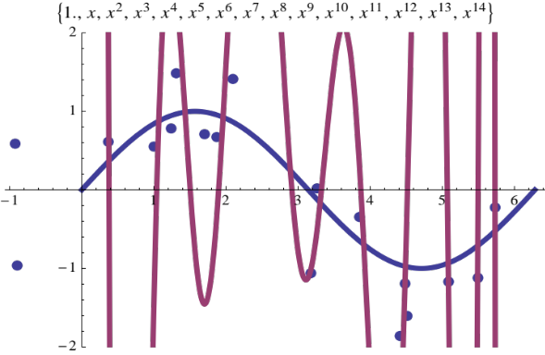
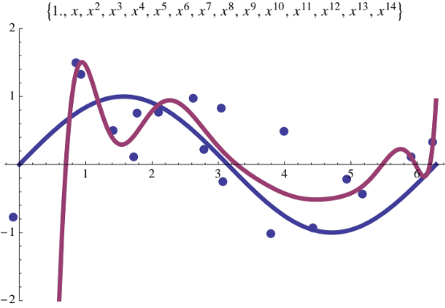
What if I train on different data?
Low Variability:
High Variability

Slide 46
Bias-Variance Tradeoff
So far we have minimized the error (loss) with respect to training data
  Low training error does not imply good expected performance: over-fitting
We would like to reason about the expected loss (Prediction Risk) over:
  Training Data: {(y₁, x₁), …, (y_{n}, x_{n})}
  Test point: (y*, x*)
We will decompose the expected loss into:

Slide 47
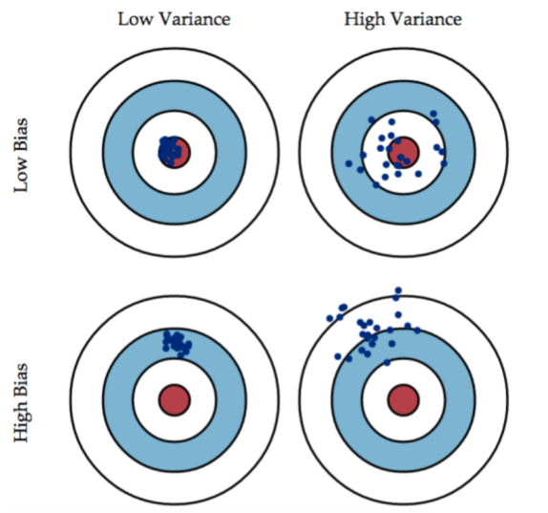
Bias-Variance Tradeoff
Bias (偏差)、Error (误差)、Variance (方差)

Slide 48





Define (unobserved) the true model (h):
Completed the squares with:
Assume 0 mean noise
[bias goes in h(x*)]
Expected Loss
a
b

Slide 49
Define (unobserved) the true model (h):
Completed the squares with:
Expected Loss
Substitute defn. y* = h* + e*
Notes:
----- Meeting Notes (2/25/14 11:04) -----
Noise assumption is zero mean.

Slide 50

Define (unobserved) the true model (h):
Completed the squares with:
Minimum error is governed by the noise.
Expected Loss
Noise Term
(out of our control)
☹
Model Estimation Error
(we want to minimize this)
Expand

Slide 51





Expanding on the model estimation error:
Completing the squares with

Slide 52


Expanding on the model estimation error:
Completing the squares with

Slide 53

Expanding on the model estimation error:
Completing the squares with
Tradeoff between bias and variance:
  Simple Models: High Bias, Low Variance
  Complex Models: Low Bias, High Variance
(Bias)²
Variance

Slide 54

Summary of Bias Variance Tradeoff
Expected Loss
Noise
(Bias)²
Variance
Choice of models balances bias and variance.
  Over-fitting ➔ Variance is too High
  Under-fitting ➔ Bias is too High

Slide 55

Bias Variance Plot
Image from http://scott.fortmann-roe.com/docs/BiasVariance.html
Notes:
Image

Slide 56





Analyze bias of
Assume a true model is linear:
Substitute MLE
Plug in definition of Y
Expand and cancel
Assumption:
is unbiased!

Slide 57

Analyze Variance of
Assume a true model is linear:
Use property of scalar: a² = a a^{T}
Substitute MLE + unbiased result
Plug in definition of Y
Expand and cancel

Slide 58

Analyze Variance of
Use property of scalar: a² = a a^{T}

Slide 59


Consequence of Variance Calculation
Higher Variance
Lower Variance
Figure from http://people.stern.nyu.edu/wgreene/MathStat/GreeneChapter4.pdf

Slide 60

Analyze Variance of
Assume a true model is linear:
Next: use matrix variance identity
Substitute MLE + unbiased result
Plug in definition of Y
Expand and cancel

Slide 61




Analyze Variance of
Define:
Use matrix variance identity:
If we assume x is iid N(0, 1):

Slide 62

Deriving the final identity
Assume x_{i} and x* are N(0,1)

Slide 63


Summary
Least-Square Regression is Unbiased:
Variance depends on:
  Number of data-points n
  Dimensionality p
  Not on observations Y
Notes:
----- Meeting Notes (2/25/14 11:04) -----
Mention linear assumption in true model

Slide 64
Gauss-Markov Theorem
The linear model:
has the minimum variance among all unbiased linear estimators
  Note that this is linear in Y
BLUE: Best Linear Unbiased Estimator

Slide 65
Summary
Introduced the Least-Square regression model
  Maximum Likelihood: Gaussian Noise
  Loss Function: Squared Error
  Geometric Interpretation: Minimizing Projection
Derived the normal equations:
  Walked through process of constructing MLE
  Discussed efficient computation of the MLE
Introduced basis functions for non-linearity
  Demonstrated issues with over-fitting
Derived the classic bias-variance tradeoff
  Applied to least-squares model

Slide 66


Slide 67
Logistic Regression

Slide 68

Classification
Learn: h:X->Y
  X – features
  Y – target classes
Suppose you know P(Y|X) exactly, how should you classify?
  Bayes classifier:
Why?

Slide 69

Generative vs. Discriminative
Classifiers - Intuition
Generative classifier, e.g., Naïve Bayes:
  Assume some functional form for P(X|Y), P(Y)
  Estimate parameters of P(X|Y), P(Y) directly from training data
  Use Bayes rule to calculate P(Y|X=x)
  This is ‘generative’ model
    Indirect computation of P(Y|X) through Bayes rule
    But, can generate a sample of the data,
Discriminative classifier, e.g., Logistic Regression:
  Assume some functional form for P(Y|X)
  Estimate parameters of P(Y|X) directly from training data
  This is the ‘discriminative’ model
    Directly learn P(Y|X)
    But cannot sample data, because P(X) is not available

Slide 70

The Naïve Bayes Classifier
Given:
  Prior P(Y)
  n conditionally independent features X given the class Y
  For each Xi, we have likelihood P(X_{i}|Y)
Decision rule:
If assumption holds, NB is optimal classifier!

Slide 71


Logistic Regression
Let X be the data instance, and Y be the class label: Learn P(Y|X) directly
  Let W = (W1, W2, … Wn), X=(X1, X2, …, Xn), WX is the dot product
  Sigmoid function:

Slide 72



Logistic Regression
In logistic regression, we learn the conditional distribution P(y|x)
Let p_{y}(x;w) be our estimate of P(y|x), where w is a vector of adjustable parameters.
Assume there are two classes, y = 0 and y = 1 and
This is equivalent to
That is, the log odds of class 1 is a linear function of x
Q: How to find W?

Slide 73

Constructing a Learning Algorithm
The conditional data likelihood is the probability of the observed Y values in the training data, conditioned on their corresponding X values. We choose parameters w that satisfy
where w = <w₀,w₁ ,…,w_{n}> is the vector of parameters to be estimated, y^{l} denotes the observed value of Y in the l th training example, and x^{l} denotes the observed value of X in the l th training example

Slide 74

Constructing a Learning Algorithm
Equivalently, we can work with the log of the conditional likelihood:
This conditional data log likelihood, which we will denote l(W) can be written as
Note here we are utilizing the fact that Y can take only values 0 or 1, so only one of the two terms in the expression will be non-zero for any given y^{l}

Slide 75

Computing the Likelihood
We can re-express the log of the conditional likelihood as:

Slide 76

Fitting LR by Gradient Ascent
Unfortunately, there is no closed form solution to maximizing l(w) with respect to w. Therefore, one common approach is to use gradient ascent
The i th component of the vector gradient has the form
Logistic Regression prediction

Slide 77

Fitting LR by Gradient Ascent
Given this formula for the derivative of each wi, we can use standard gradient ascent to optimize the weights w. Beginning with initial weights of zero, we repeatedly update the weights in the direction of the gradient, changing the i th weight according to

Slide 78

Regularization in Logistic Regression
Overﬁtting the training data is a problem that can arise in Logistic Regression, especially when data has very high dimensions and is sparse.
One approach to reducing overﬁtting is regularization, in which we create a modiﬁed “penalized log likelihood function,” which penalizes large values of w.

Slide 79


Regularization in Logistic Regression
The derivative of this penalized log likelihood function is similar to our earlier derivative, with one additional penalty term
which gives us the modiﬁed gradient descent rule

Slide 80
Summary of Logistic Regression
Learns the Conditional Probability Distribution P(y|x)
Local Search.
  Begins with initial weight vector.
  Modifies it iteratively to maximize an objective function.
  The objective function is the conditional log likelihood of the data – so the algorithm seeks the probability distribution P(y|x) that is most likely given the data.

Slide 81
What you should know LR
In general, NB and LR make different assumptions
  NB: Features independent given class -> assumption on P(X|Y)
  LR: Functional form of P(Y|X), no assumption on P(X|Y)
LR is a linear classifier
  decision rule is a hyperplane
LR optimized by conditional likelihood
  no closed-form solution
  concave -> global optimum with gradient ascent

Slide 82
Thank You!

